Slide 1
Data Analysis
Presented by: Kalyani Korde
Email:kordekalyani361@gmail.com
Notes:
Data analysis presentation
https://1drv.ms/p/c/8c19a627539fafa0/EYw54g6geY1GsP576j_TyiMBaCCge6dzdFZug5h6yM6C5w?e=7fCwAl

Slide 2
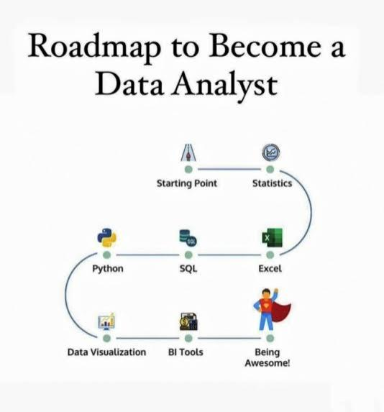

Slide 3
Statistics
    Introduction to statistics :
    Definition: Facts or pieces of information
    Data: Facts or pieces of information
    E.g.: 1. Height of students in classroom.
    2. No. Of sales in terms of revenue of a company
    3.IQ of students in classroom
    Type of statistics:
    1.Descriptive statistics
    2.Inferential statistics

Slide 4
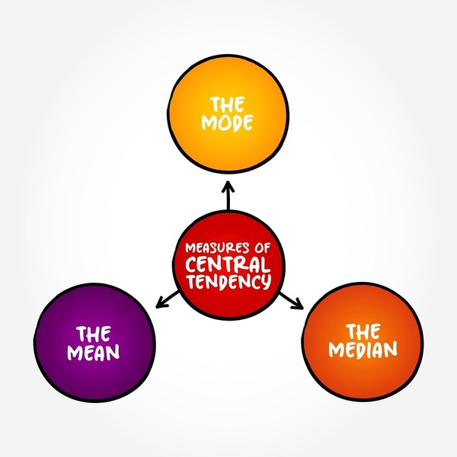
1.Descriptive Statistics
1. Descriptive statistics –It is consistent of organizing summarize and visualizing data
Example: 1. Measure of central tendenccies.

Slide 5
2.Inferential Statistics
Inferential statistics are used to make conclusion about the population by using analysis tools on the sample data.
Measure of inferential statistics are
T-test
Z-test
Chi square test
Anova test
P_value

Slide 6
Question ❓
Let say there are 10 cricket camp in Bangalore and you have collected the height of cricketers from one of the camp.
Height is recorded are (175cm,180cm,140cm,135cm,160cm,135cm)
2.Descriptive Question –
What is the average height of entire camp.
Disturbance of a Data
Are the average height of player of camp 1similar to that of camp2.
140cm how many STD it is away from mean.

Slide 7
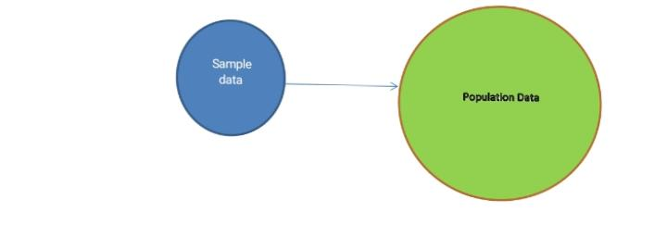
Population and sample data
Population data(N): Population is a group
Or a subset of data that you are interested
Studying.
Sample data(n): A sample is a subset of population data.

Slide 8
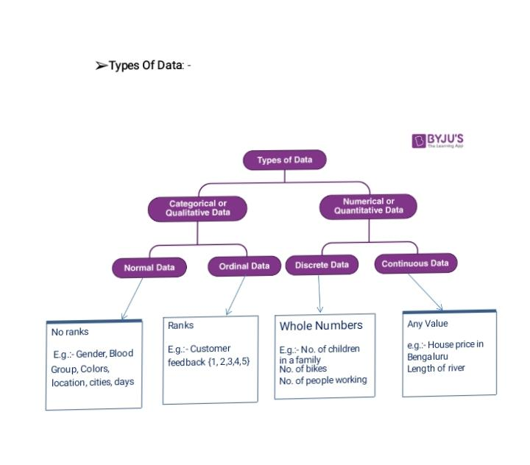
Type of Data

Slide 9
Descriptive statistics
1.Measure of central tendency:
Means
Median
Mode

Slide 10
Mean , Mode and Median
1.Mean:The mean represents the average value of the data set it can be calculated as the sum of the value in the dataset by the number of value.
Means=x1+x2+x3/n
2.Median Median is the middle value of the data set in which the data set is arranged in the ascending in order or in decreasing order. When the dataset contains an even number of value,then the median value of the dataset can be found by taking the mean of the middle two values. Considered the given dataset with the odd number of observation is arranged in descending order (24,21,18,16,15,13,12,10,9,7,6,5and2)
Answer:12

Slide 11
Central tendency
If the given dataset represent (40,38,35,30,29,27,26,24,23,22,19,17)
N+1/2=27+29/2=28
Therefore ,the median for the given data distribution is 28.
3.Mode:The mode represents the frequent occuring value in the dataset. Sometimes the dataset may contain multiple model and in some cases it does not contain any mode at all
Considered given dataset 5,4,2,3,2,1,5,4,5
Mode=5

Slide 12
2.Measure of dispersion
Dispersion is the state of getting dispersed or spread. Statistical dispersion means the extent to which numerical data is likely to vary in the value.
Range
Variance
Standard deviations
Coefficient of variation (cv)
Correction

Slide 13
Measure of dispersion
Range :It is difference between the maximum and minimum value of the data set.
It is affected by outlier
Class room age (17,18,19,20,18,20,18,17,71)
Here 71 is the outlier.

Slide 14
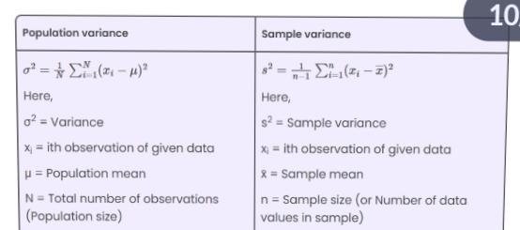
2.varience
The sample variance is divided by n-1 so that we can create an unbiased estimator of the population variance.
More the spread more the variance.

Slide 15
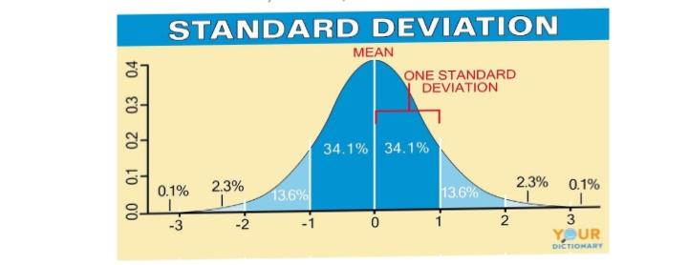
2.Standard deviations
The square root of the variance is known as the standards deviation..
A standard deviations is used to determine how estimated for a group of observation are spread out of the mean
How many STDX is away from mean

Slide 16
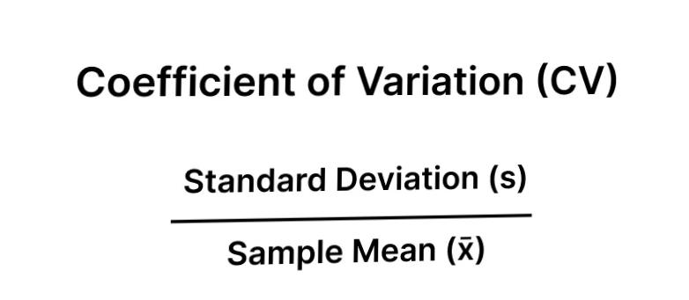
Coefficient of variation (cv)
The cv is the ratio of standard deviations to the mean express in percentage.
Range=- ♾️to♾️

Slide 17
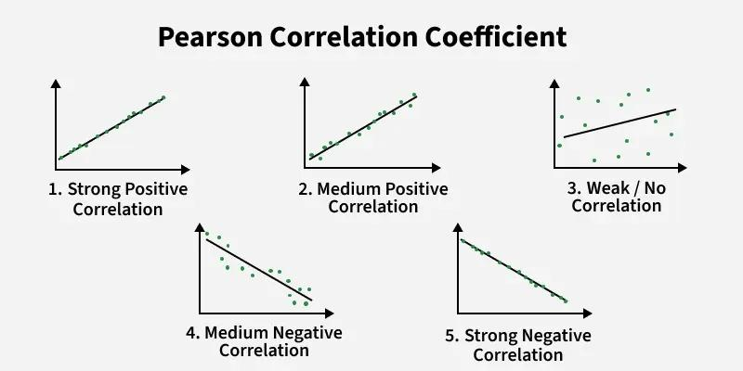
Pearson correlation
The Pearson correction ® is the most common of measuring a linear correlation. It is a number between -1to 1 that measures the strength and direction of the relationship between two variables.

Slide 18
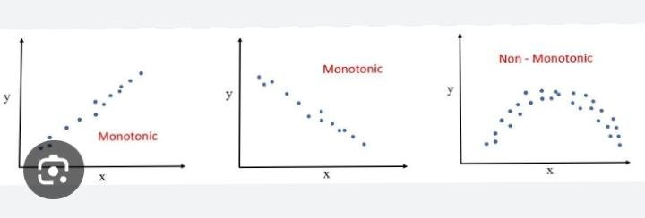
Spearman correction
A correlation can easily be drawn as a scatter graph,but the most precise way to compare several pairs of data is to use to a statistical test this established whether the correlation is really significant or if it could have been the results of chance alone.

Slide 19
Type of questions
What is the difference between population and sample?
Why we used the sample data in inferential statistics?
What is the quantitative data and qualitative data?
What is mean?
What is mean by standards deviation?
What does mean by symmetric mean?
What is relationship between median,mean and mode in normal distribution?
What is mean by correction?

Slide 20
Graph of Analysis
Univariate analysis
Bivariate analysis
Multivariate analysis

Slide 21
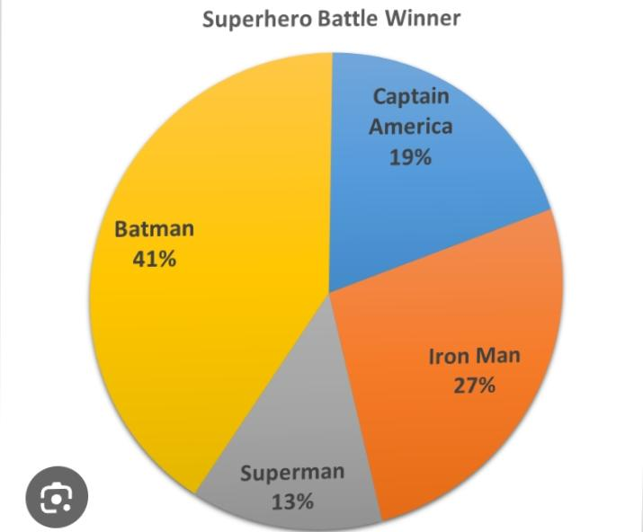
1.Univarient analysis
Relative frequency
The number of times the event occurred divided by the total number of events.

Slide 22
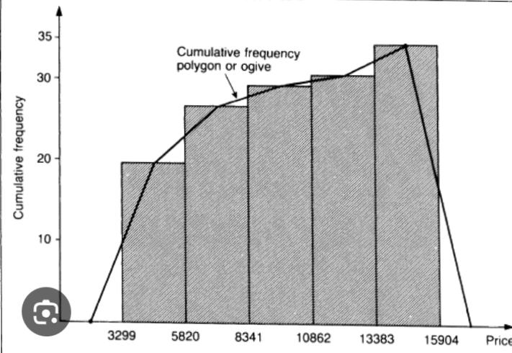
2.Cummularive frequency
Cumulative frequency is the total of the frequency and all frequency in a frequency in a frequency until a certain defined class interval

Slide 23
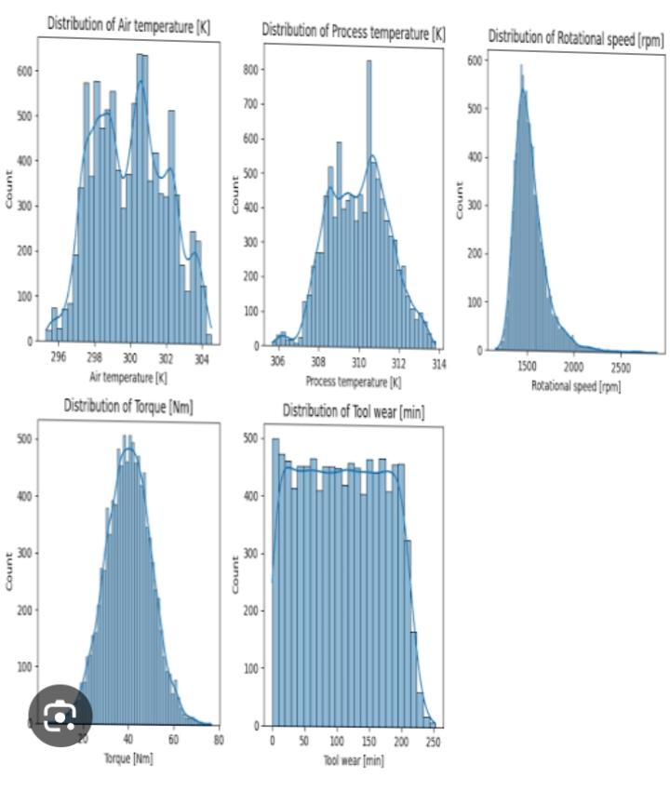
3.Numerical features

Slide 24
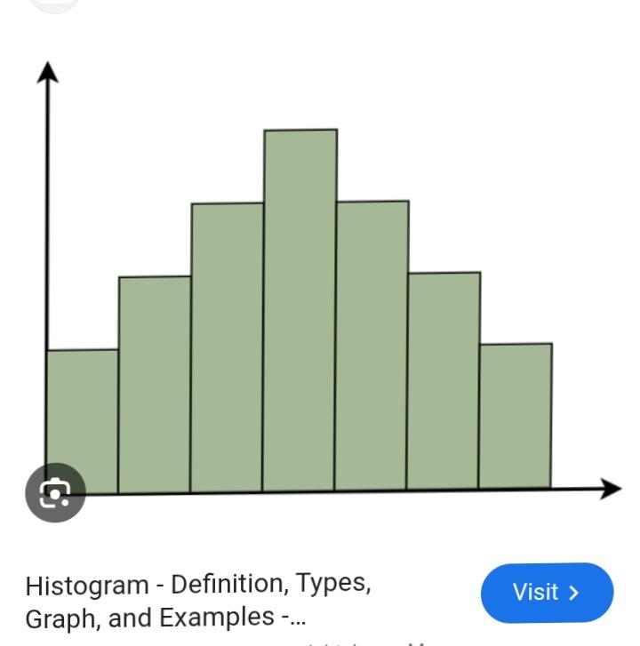
4.Distribution of Numerical features

Slide 25
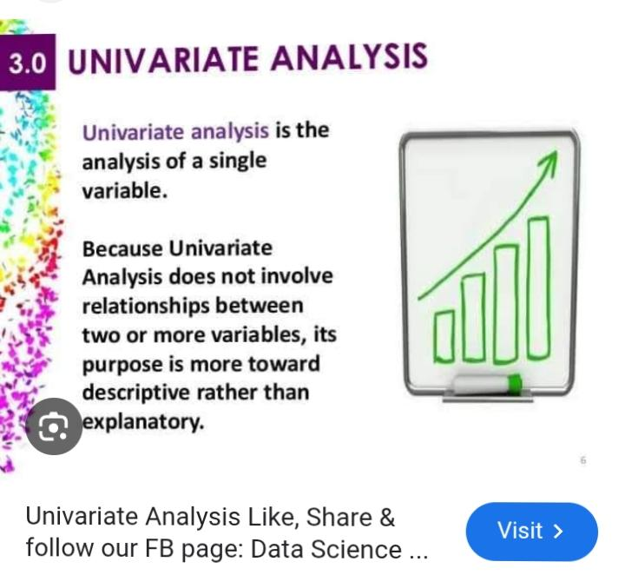
2.Bivarient analysis

Slide 26
Quantile and percentile
1.Quantile: It’s a statistical measure used to divide a set of Numerical data into the equal size group.
They can also be used to identify the outlier.
2. Quartile: we divided the data into four equal plot.
3.Quintile: We divided the data set into five equal parts.
4.Decile: we divided the data into ten equal parts.
5.Percentile: We divided the data into 100 equal parts.

Slide 27
Quantile calculation formulas
Quartile then the results is the location not a Data point
PL=P/100(N+1)
N=number of population data.
P=percentile Rank
PL=Data location

Slide 28
To detect the outlier in the dataset
Five number summary
We ca calculate five number summary in the dataset by dividing the data into four equal parts.
Minimum value: The minimum value after dividing the data into four equal parts.
Q1(first quartile): The value that separate the lowest 25% of data.
Q2(second quartile): The value that separate the 50%of dataset.
.Q3(Third quartile):The value that separate the 75%of the dataset.
Maximum value: The large value of dataset.

Slide 29
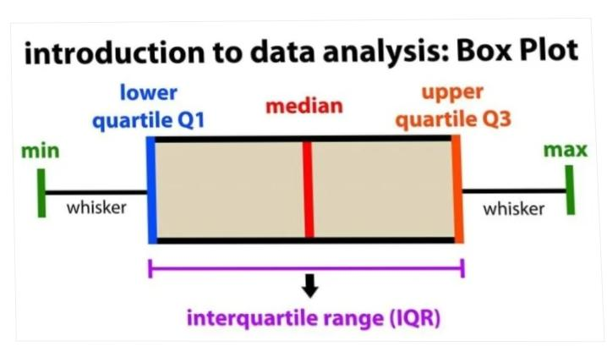
IQR(Interqurtile Range)
The IQR is based upon on five number summary and calculate as difference between third quartile and first quartile.
:IQR= Q3-Q1
Lower bounds (min):(Q1-1.5*IQR)
Upper bound (max):(Q3+1.5*IQR)

Slide 30
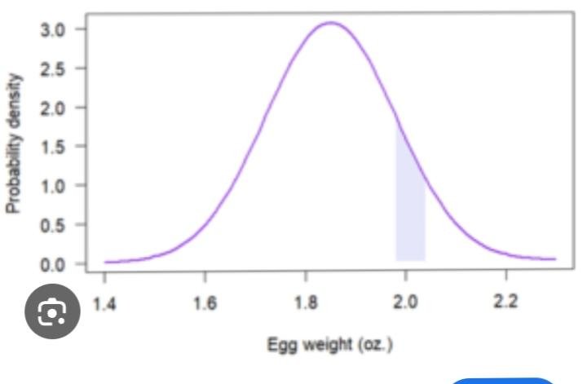
Probability distributions functions
It helps to identify the distribution of the data in graphical form .
If any function matches the standards deviation then we can calculate every thing about the data standard formula.
It have two types Probability density function and probability mass function.

Slide 31
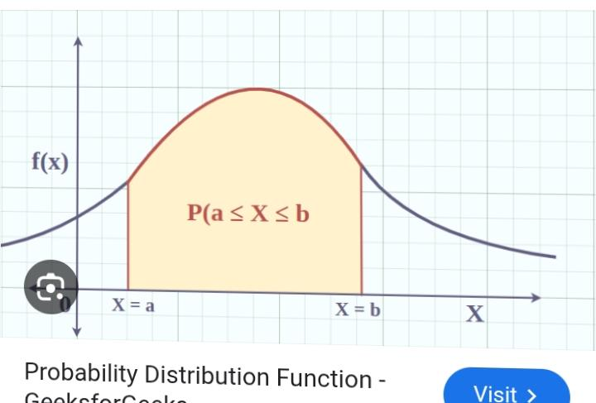
1.Probability density function

Slide 32
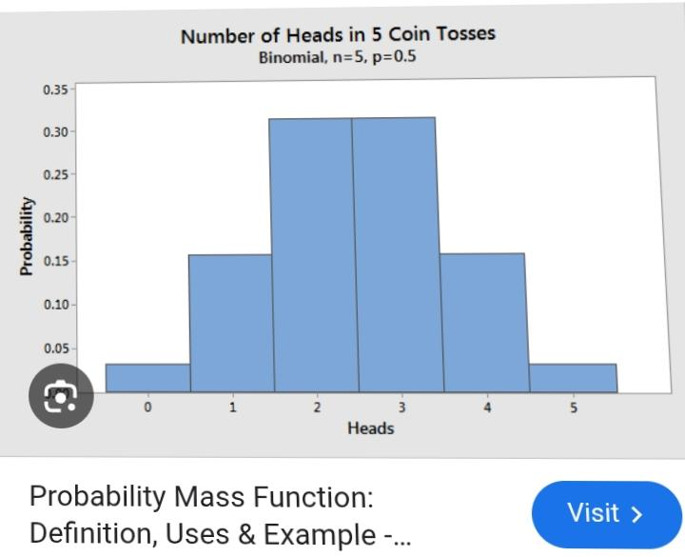
2.Probability mass function
Probability mass function till 4 in die
=P(1)+p(2)+p(3)+p(4)
=1/6+1/6+1/6+1/6
=2/3

Slide 33
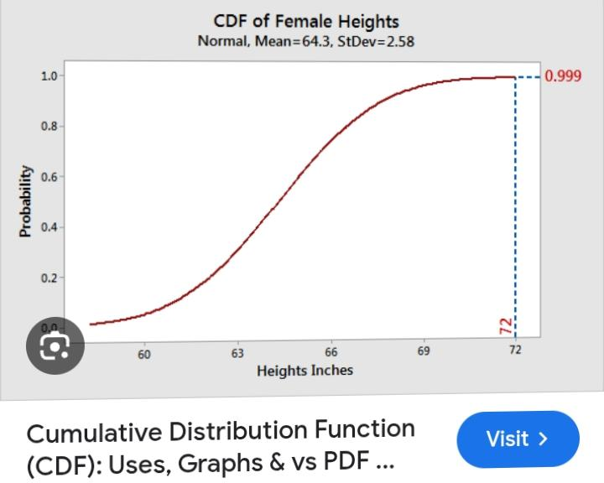
Cumulative density function
It is a continuous function.
It is Range: 0 to 1

Slide 34
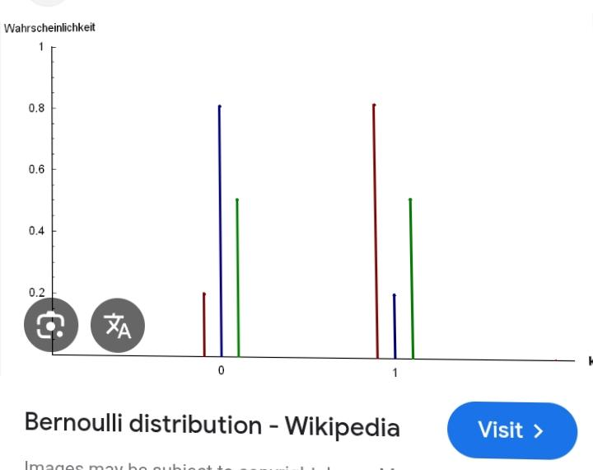
1.Bernaulli Distribution
It is a decrete probability distributions .
It is concern with PMF.
Example: It applies to event that have trial and two outcomes. There are known as Bernoulli distribution .
Example 2.: one trial and two outcomes
  Total probability= 1
  If p(H)= 0.8
  P(T)=0.2

Slide 35
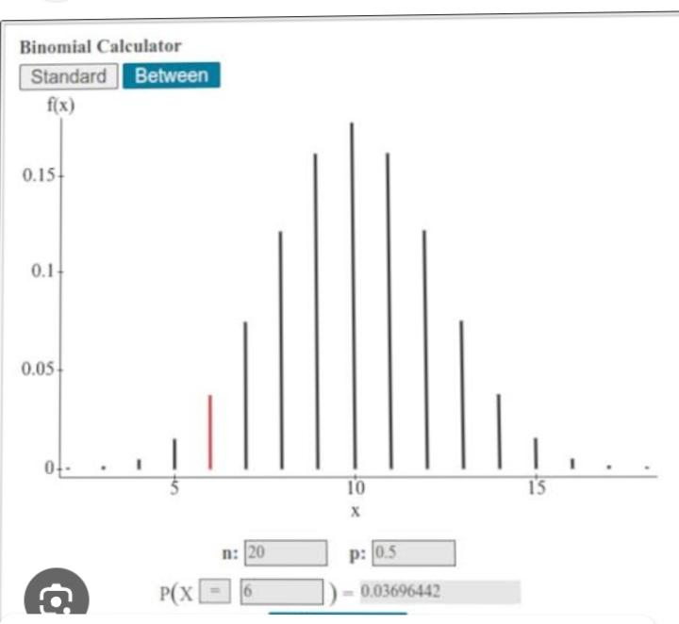
2.Binomial distribution
It is a decrete probability distributions.
It is concern with PMF
It applies to the event where n no. Of trial and two possible outcomes.
N number of trial is a independence trial.
Example: Tossing a coin 5 times
p(h)=0.3,p(h)=0.4,p(h)=0.5,p(h)=0.7,p(h)=0.9

Slide 36
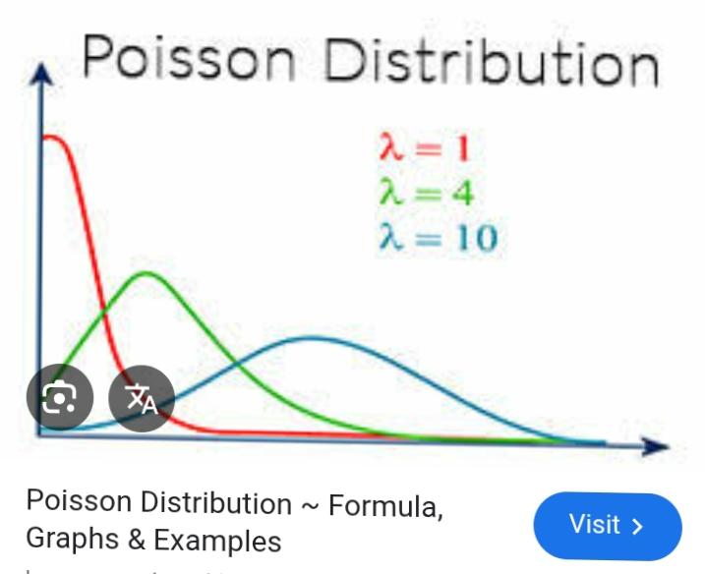
3. Poisson Distribution
It concern with PMF
Descrete probability distributions
It appiled to the no. Of events occurring in fix interval of time.
Example : Customer visiting a bank after every 1hr.

Slide 37
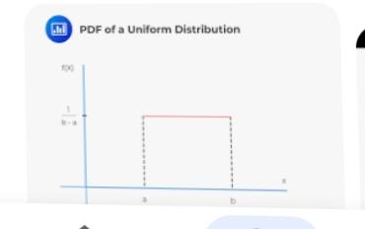
4. Uniform distribution
It is applied an event occurring follow uniform probability

Slide 38
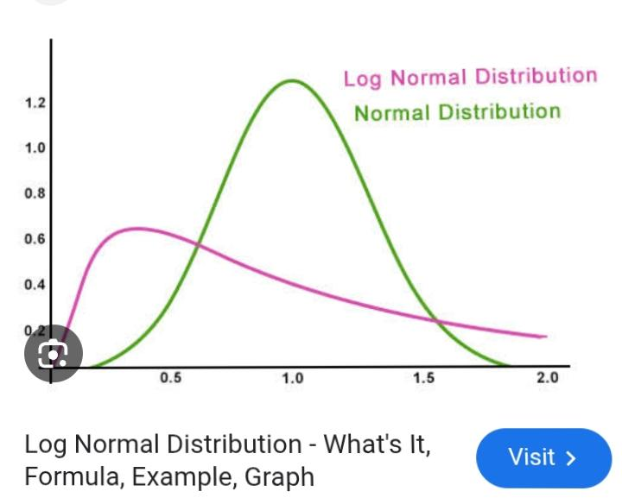
5. Log-distribution

Slide 39
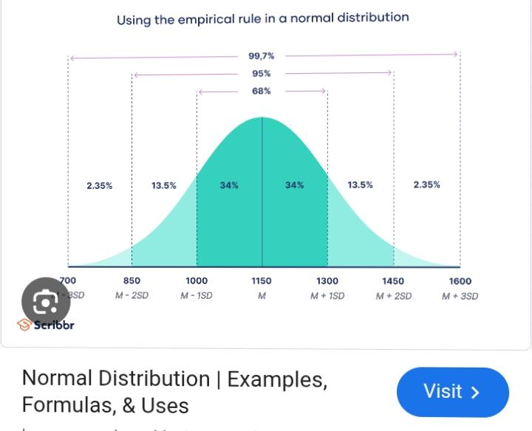
6. Normal/Gaussian Distribution
It concern with PDF
While the distribution follow symmetric curve.
When mean=mode=median

Slide 40
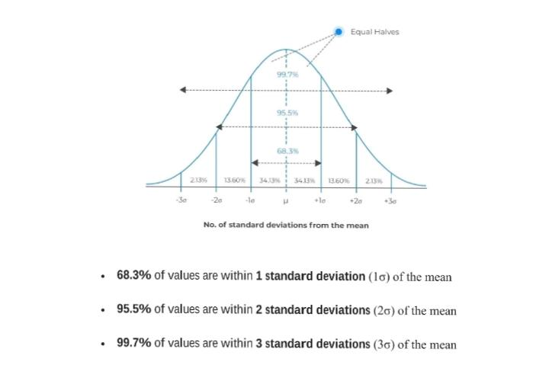
Empirical Rule of Normal distribution
The empirical Rule in statistics also known as the 68 95 99 rule, state that for normal distribution,68% of based data point will lie inside one standard deviations of mean ,95% will in two standard deviations, 99.7% will occur in three standard deviations.

Slide 41
Type of questions
What is 5 number summary?
What is the benefits of using Box plot?
What is outlier?
How you find out outlier?
What does bell curve distribution means?
What is left-shewed distribution?
What is mean by right –skewed distribution?

Slide 42
Sampling techniques
Simple random sampling population You want to select a simple of 1000 employee of social media marketing company.You assign a number to every employee in the company database from 1to 1000,and use a random number generator to select 100 number.
Stratified sampling: Stratified sampling involves dividing the Population into subpopulation that may differ in important ways It allow you more precise conclusion by ensuring that every subgroup is properly represents in the sample.
To used this method, you divided the population into the subgroup based on the relevant characteristics.

Slide 43
Sampling techniques
3.Systematic sampling: Systematic sampling is similar random sampling, but it is usually slightly easier to conduct. Every member of the population is listed with a number, but instead of randomly generated number, individual chooses in random interval.
4.Convenience Sampling: A convenience sample simply include who happens to be most accessible to the researcher.
This is an easy and inexpensive way to gather initial data, but there is no way To tell if the sample is represented of the population, so is can’t produce generalized results. Convenience samples are at risk both for sampling bias and selection bias

Slide 44
Sampling techniques
3.Purposive sampling: This type of sampling also known as judgement sampling, the researcher using their expertise to select a sample that is most useful to the purpose of the research. We collect it on bases of purpose.
4.Cluster sampling : Cluster sampling also involved dividing the population into subgroup but each subgroup should have similar characteristics to the whole sample. Instead of sampling individual from each subgroup, you randomly select entire subgroup.

Slide 45
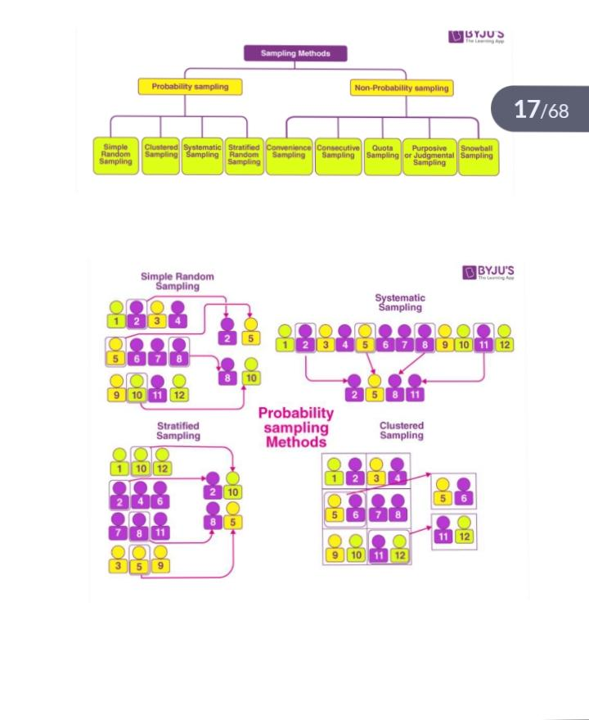

Slide 46

Thank you

